Slide 1
21st CCLC FY27 RFA
Technical Assistance Webinar, Part II
Grant Application Instructions
Alaska Department of Education & Early Development
Jessica Paris, 21st CCLC Program Manager
February 27, 2026

Slide 2
Mission, Vision, and Purpose
Mission | Vision | Purpose
An excellent education for every student every day. | All students will succeed in their education and work, shape worthwhile and satisfying lives for themselves, exemplify the best values of society, and be effective in improving the character and quality of the world about them. - Alaska Statute 14.03.015 | DEED exists to provide information, resources, and leadership to support an excellent education for every student every day.

Slide 3

Strategic Priorities:
Alaska’s Education Challenge
Five Shared Priorities:
Support all students to read at grade level by the end of third grade.
Increase career, technical, and culturally relevant education to meet student and workforce needs.
Close the achievement gap by ensuring equitable educational rigor and resources.
Prepare, attract, and retain effective education professionals.
Improve the safety and well-being of students through school partnerships with families, communities, and tribes.
education.alaska.gov/akedchallenge

Slide 4
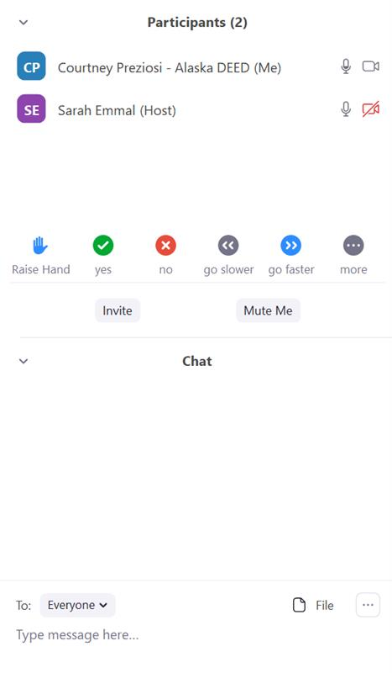

Engage by using the tech:
Transcript: This will display a running transcript. Find by selecting from More button.
Show Captions: This will display live closed captions.
Open your Participant window
Open your Chat window
Locate your Microphone button
Locate your Video button
Locate your Reactions button
Locate Hand-raising button
Audio and Video Settings.
Click icon to turn on or off. Red slash through the icon indicates that it is turned off.
Click arrow (^) to the right of each icon for more settings (e.g., change microphone, virtual backgrounds).
Chat: This will allow you to chat with the Host and other participants.
React: This will allow you to use an emoji to provide a reaction without interrupting the meeting. Reactions will disappear after 5 seconds. Raise Hand might be found here or as its own button
Leave microphone muted until speaking

Slide 5
Before we get started…
This is being recorded
Keep microphone off or telephone muted
I will try to pause between major topics for questions
Ask generalized questions relevant to entities other than yourself
If you have a question—
  Write in the chat and/or
  Raise hand
  If only on phone line, wait for pause and then state “I have a question”

Slide 6
Who is here?
In the chat box, type:
  Name
  Community
  Organization
  Email address

Slide 7
Agenda
Overview of 21st CCLC
FY27 21st CCLC Application Directions
Overarching Tips
Next Steps
Questions

Slide 8
Overview of 21st CCLC
21st Century
Community Learning Centers Program

Slide 9

Overview of 21st CCLC webinar topics
See the 21st CCLC Webinar presented on Wednesday, February 25, which addressed these topics—
Funding source
Purpose of funds
Expected and allowable activities and services
Schedules
Staffing
Facilities
Eligible applicants & schools
Funding parameters
“Supplement not supplant” requirement
Reporting requirements
Tips
Resources

Slide 10

Purpose of 21st CCLC funding
Increase student academic achievement
Provide educational opportunities outside of the school day that align with regular day
Particularly for students who attend high-poverty, low-performing schools

Slide 11

Increase academic achievement
Academic assistance
English language arts and mathematics instruction
Targeted tutoring, skill building
Homework/classwork help
Credit recovery, Credit accrual
Smaller student to staff ratio; aligns with regular school day
Educational enrichment
STEM projects, science clubs, coding, robotics, math games,
Art, music, theatre, cultural activities, second language, cooking, dance, chess
Structured physical activity—archery, swimming, NYO, Girls on the Run
Career readiness & competency building, employer-recognized credentials, service learning
Social, Emotional, Non-cognitive and/or life skills building
Intentionally designed to support Positive Youth Development
Social/Emotional instruction with evidence-based curriculum
Skill practice embedded in project-based learning
Drug and violence prevention, counseling
Support family engagement
Family literacy or math night
Train parent to use online resources
Facebook and newsletter stories
Parent as volunteers, instructors, advisors

Slide 12
What are effective program schedules?
Variety of classes and choice that attract voluntary participation and meet student needs and match staff skills
Sustained units (not one-offs) that allow students to progress
Participation in different types of programming (e.g. academic and enrichment and SEL) is allowed/encouraged/required
“Veggies” shouldn’t have to compete with “dessert”
Small class sizes that allow for more 1 on 1, student leadership, relationship building, staff who can’t manage 30 students
One- or two-day commitment per week from instructional staff allowable
One “super” or “club” day different from other days
Ability to earn high school credit or employer- or industry-recognized credential
Coordinated with other popular programming instead of competing

Slide 13
Additional features of 21st CCLC programs
Free snack or meal without using 21st CCLC funds, such as
USDA NSLP Afterschool Snack
USDA CACFP Meal or Snack
USDA Summer Food Service Program Meals or Meal and Snack
Safe transportation to and from program, such as
Contract for bus
Wages for driver of school vehicle,
Everyone safely walks
Regular attendees
All program participants must be enrolled in program
Must attend at least 75 hours to be counted as regular attendee
Target Cost and reasonable funding based on regular attendees
Coordination
With pre-existing and concurrent programs
With other federal, state, and local funds
With regular school day
Evaluation process
Data
External observation
Performance Indicators
Ongoing Continuous Quality Improvement

Slide 14
Supplement not supplant
Supplement = Allowed
Create brand new program
Supplant = Not Allowed
Offer the same programming you offered in the prior year but swap how it is paid for
Add/replicate successful program at a new additional site
Double the number of students previously served; double the number of days of operation. 21st CCLC pays only for the new students/services.
Use 21st CCLC funds to operate a program previously funded by COVID money that died September 2024.
Significantly add on to a current program and fund pre-existing part with non-21st CCLC funds
Incorporate traditionally offered activities into a 21st CCLC program and pay for the activities using 21st CCLC funds
Use 21st CCLC funds to operate a program previously funded by the district’s BSA, Title I-A, Title IV-A, CTE, etc.
Use 21st CCLC funds to operate a program previously funded by fundraising activities.
Use 21st CCLC funds to pay for an activity required by federal, state or local law
Use 21st CCLC funds to operate a program previously funded by a 21st CCLC grant that ends June 30, 2025.

Slide 15
Application Directions
Sections III and IV

Slide 16
Open RFA document and webpage
Get out RFA document
Open the DEED 21st CCLC webpage Grant Competitive Opportunities tab
As I go through components, type questions in chat box or raise hand

Slide 17
Application Submission
Applications submitted late, faxed, and/or severely incomplete will not be reviewed
Tip: Submit 24 to 48 hours in advance
Warning: 3 applications were received late last year; none were reviewed
Due April 1 at 1:00 PM
One single electronic PDF
Sent via ZendTo

Slide 18
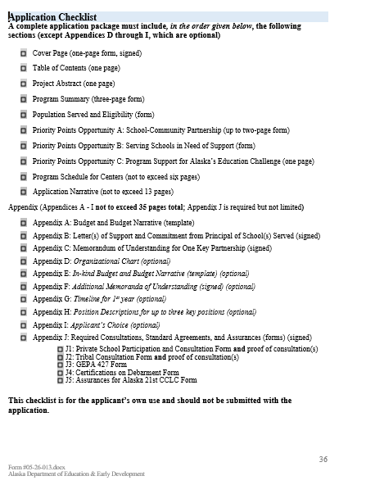

Application Checklist
Page 36
Brief list of all Application Package components
Use this as checklist and to make Table of Contents
The subsequent slides will follow the order of checklist except—
I am beginning with Program Served and Eligibility Form
  It is foundation of application
  So many other components are based on it

Slide 19
Population Served and Eligibility Form
At least 60% of the students served must attend schools that are economically disadvantaged
  Poverty rates of 40% or greater or designated Title I-A Schoolwide
  To count as “served” student must attend program on 75 hours or more during the school year (doesn’t include summer)
  See 21st CCLC DEED School Data Sheet for FY27 RFA, which is the only allowable data source
If you complete form and are not eligible (not over 60%) don’t apply
Tip: Make sure your form is in alignment with page 2 of Program Summary Form and Priority Points Opportunity B
Tip: Do this form first
Form on page 43
Example on page 44

Slide 20
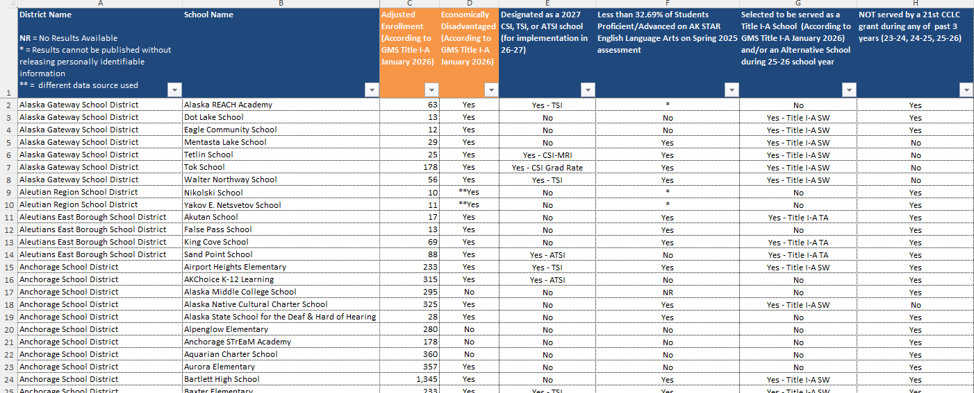
21st CLCC DEED School Data Sheet
Found on DEED 21st CCLC Website
Use to complete Eligibility Form
Use “filters” to simplify task
Use School Enrollment information (Column C)
Use Economically Disadvantaged data (Column D)
This Data Sheet is the only allowable data source for this form and to determine eligibility
Contact Jessica.paris@alaska.gov quickly if you believe the data is in error

Slide 21
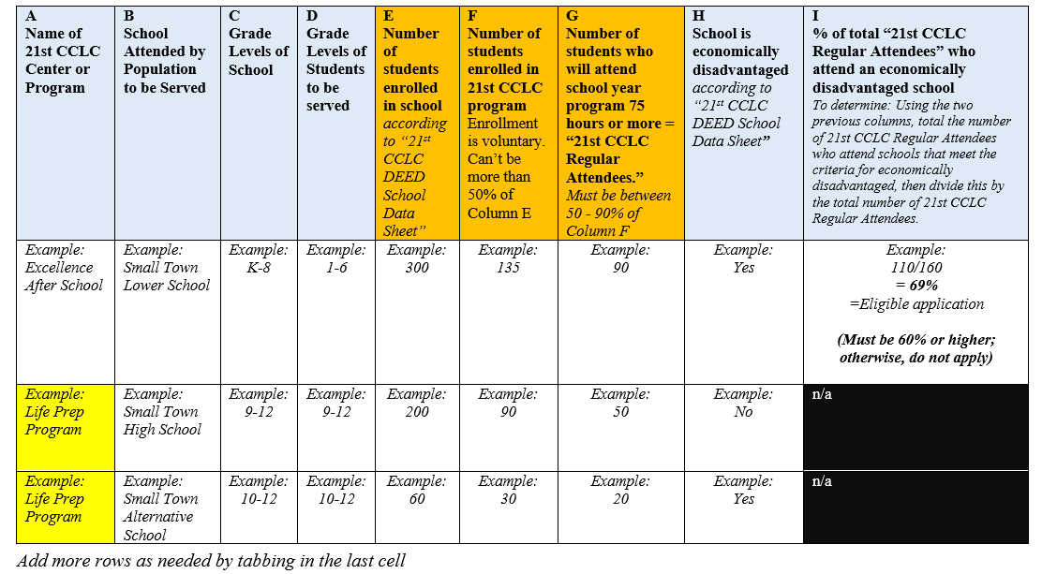
Eligibility Form Example
Column F requires you to list how many students will be enrolled in the 21st CCLC program. The RFA forbids applicants from promising to serve more than 50% of the school population.
Column G requires you to list how many students will be regular attendees, which means they will (voluntarily) attend the program 75 hours or more during the school year. The RFA forbids applicants from promising that fewer than 50% and more than 90% of the number of students enrolled in the 21st CCLC program will be regular attendees.
Note: During actual implementation, it is fine to exceed the numbers in columns F and G.
Note: Make sure these numbers match the numbers in the Program Summary Form.
Note: In this example, the Life Prep Program is “fed” by two “feeder schools”: Small Town HS and Small Town Alternative School
The Excellence Afterschool Program is only fed by one school: Small Town Lower School

Slide 22
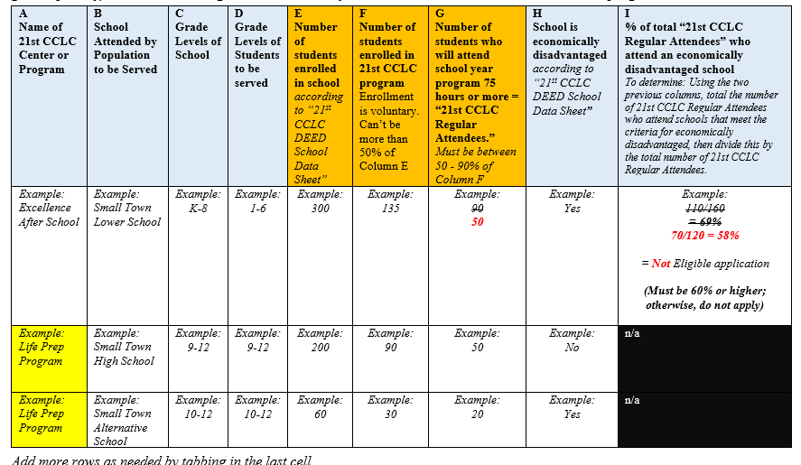
Eligibility Sheet: Example of Not Eligible

Slide 23
Cover
Page
Okay to use electronic signatures on cover and throughout
Tip: Don’t run entire application through Docusign
Tip: Don’t attach all the Docusign documentation
Form on page 39

Slide 24
Table of Contents
Detail is helpful for reviewers (and future director)
Tip: Try MS Word’s tools for making Headers and Table of Contents that automatically updates page numbers.
Tip: Might be able to repurpose the RFA document and use its heading and formatting
Tip: Otherwise, add page numbers to Table of Contents last.
No form
One page
Include page numbers that correspond with pages of application, including appendices

Slide 25
Project Abstract
Shortcut for reviewers to understand the basics of who you are, what you intend to do, and why you are likely to succeed
Gives reviewer framework or context for the disparate parts of the application
Allows you to summarize your project or tell your story in less structured way
Tip: It is the reviewer’s first impression—make it good
No form
One page narrative describing the project

Slide 26
Program Summary Form
Good orientation for future local program Director
Grantees will see form and numbers again during program reporting and monitoring
Keep an eye on whether cost per student is aligned with the Target Cost per Regular Attendee, competitive, and reasonable for likely gain
Tip: Do a draft near beginning but revise at end of application process. Triple check for error and inconsistencies before final submission
Warning: If your application has errors or inconsistencies here or elsewhere, DEED will mark it up and alert reviewers
Form on pages 40, 41, and 42
Primarily a summary of grant facts from rest of application
Information must match rest of application package
Allowable for table(s) on second page to expand to another page
20 points for AA3

Slide 27
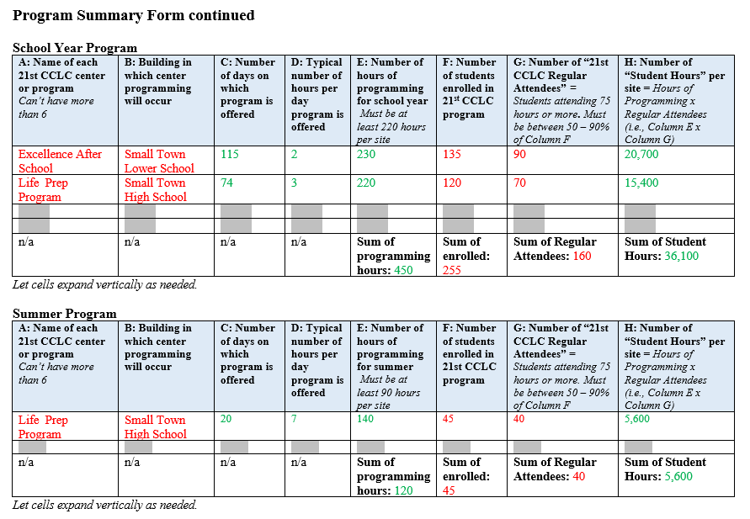
Program Summary Form page 2 Example
Make sure this form is in alignment with Population Served and Eligibility Form and Schedule of Center Programming and page 3
For Sum of Student Hours, must add up subtotals in Column H, not multiply Column E total by Column G total.
Use Comparable Cost Calculator

Slide 28
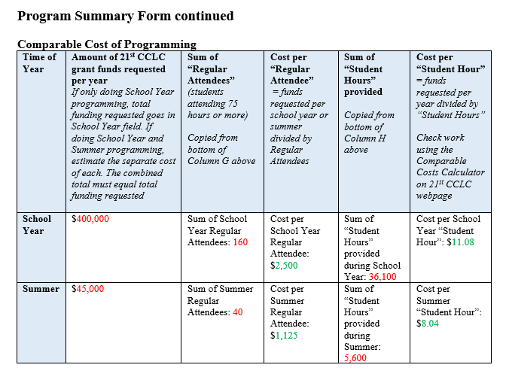
Program Summary Form page 3 Example
Make sure this form is in alignment page 2 and with Budget
Use Comparable Cost Calculator

Slide 29
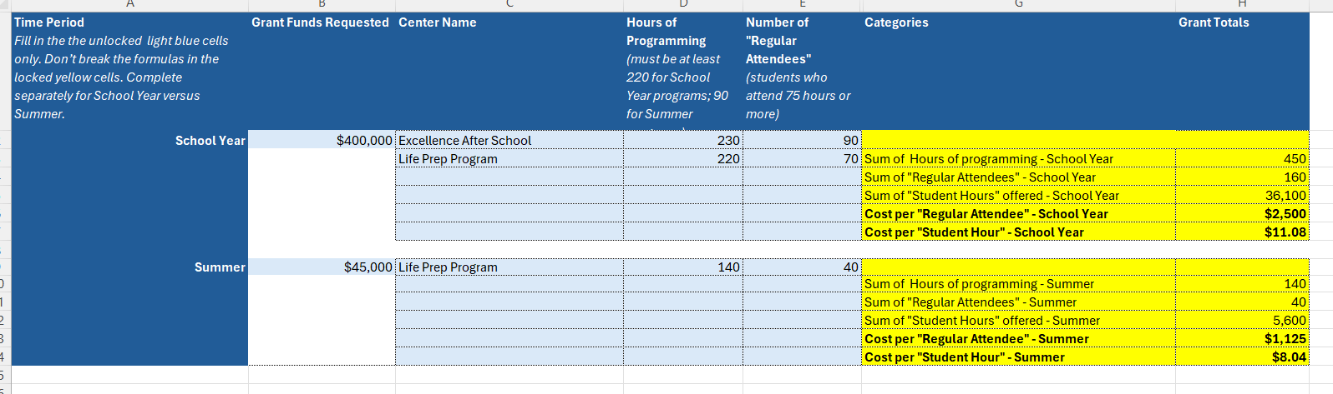
Comparable Cost Calculator Example
Don’t break the formulas
I plan to revise formatting to allow cents be included in the “Student Hour” totals

Slide 30
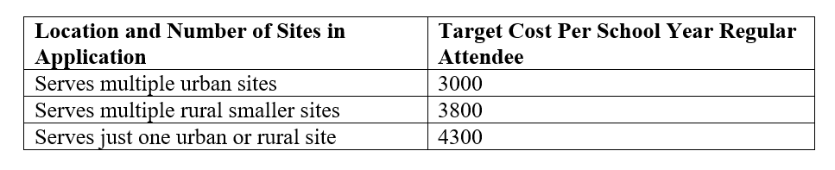
Target Cost per Regular Attendee
Regular Attendee attends School Year program at least 75 hours
Aim for application’s cost per school year Regular Attendee to meet or be less than the applicable Target Cost above (and on page 22 in RFA)
However, if exceed the Target Cost, the application isn’t ineligible, just less competitive
Scoring item AA3 (20 points) aims to reward applications that coordinate funds to bring down the cost per Regular Attendee
Don’t set your future Director up for failure: Don’t set an unrealistic number of Regular Attendees to try to drive down the cost per Regular Attendee

Slide 31
Priority Points A, B, and C
An application can ask for and be awarded in all three opportunities:
  A: 10 points
  B: Up to 20 points
  C: 5 points
No application will be awarded more than 35 total priority points
The application must complete parts A, B, and/or C to receive the priority points

Slide 32
Priority Points A: School-Community Partnership
If school district is lead applicant, partner with non-school entity (non-profit, tribal, etc.)
If non-school entity is lead applicant, must partner with school district for these points
Clarification: Partnership can involve paid services, but not necessary
Reminder: If paying partner, ensure you follow your organization procurement protocols
Reminder: Can’t contract with any one entity for more than 10% of total grant award
Tip: Also describe relationship in MOU in Appendix C
Form on page 45
10 points

Slide 33
Priority Points B: Serving Schools in Need
Priority points for serving schools meeting criteria of “need”
  Designated a 2027 CSI, TSI, or ATSI school (for implementation in 26-27)
  Fewer than 32.69% of students were proficient/advanced on PEAKs ELA in Spring 2025
  Title I-A site (Schoolwide or Targeted Assistance) and/or Alternative School in 25-26 school year
  Not served by 21st CCLC grant in any of past 3 years (23-24, 24-25, 25-26)
See 21st CCLC DEED School Data Sheet for FY27 RFA, which is the only allowable data source
Tip: Only 20 points out of 325. You may be able to write an overall stronger grant application with the right school and focus instead of the one scoring the most priority points. Consider:
  Who needs the program
  Who wants the program
  Who has the staffing, resources, ability to deliver program
Form on page 46
Example on page 47
Up to 20 points

Slide 34
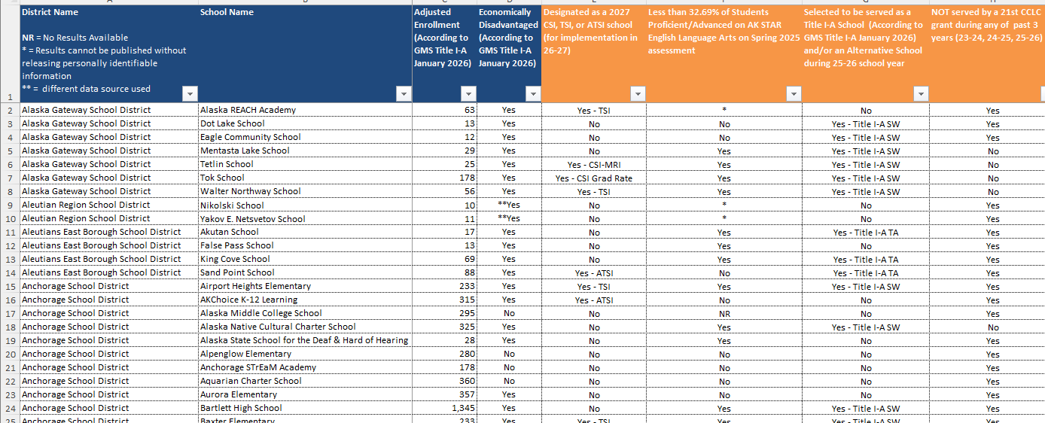
21st CCLC DEED School Data Sheet
Found on DEED 21st CCLC Website
Use to complete Priority Points Opportunity B
Use “filters” to simplify task; look for “yeses”
Use information in Columns E to H
Make sure this form is in alignment with Population Served and Eligibility Form and page 2 of Program Summary Form
This Data Sheet is the only allowable data source for this form and for these priority points
Contact Jessica.paris@alaska.gov quickly if you believe the data is in error

Slide 35
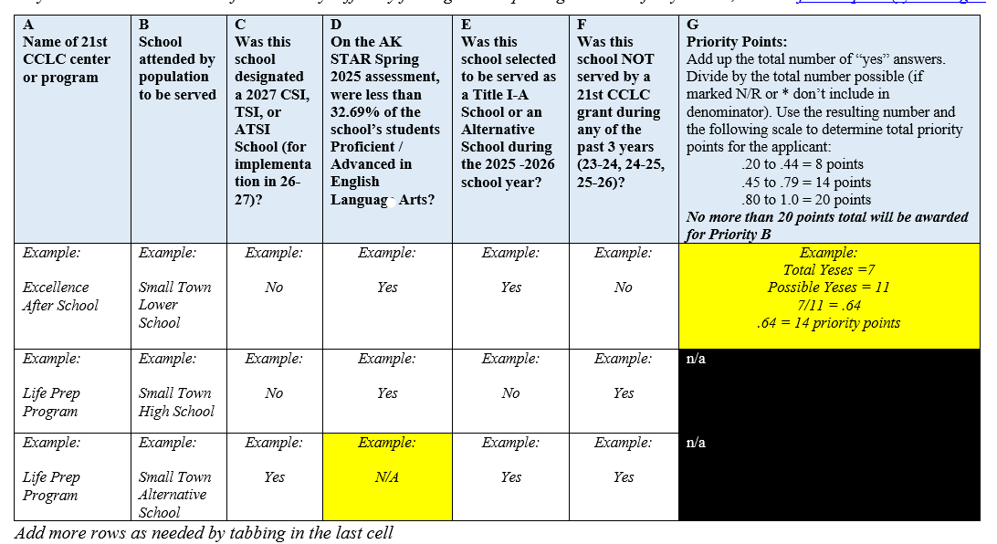
Priority Points B Form
The sum of the total number of criteria each served school meets will be divided by the total possible number.
Criteria marked “N/R” or “*” for a school in the “21st CCLC DEED School Data Sheet” are not counted (not in numerator nor denominator)
Priority points will be awarded based on the following:
  .20 to .44 = 8 points
  .45 to .79 = 14 points
  .80 to 1.0 = 20 points

Slide 36
Priority Points C: Programmatic Support for Alaska’s Education Challenge
Narrative must meet both of the following criteria:
  1) offering meaningful inclusion of any one of the activities listed, and
  2) assuring the activity is not currently accessible to the students and families who would be served by this application, or that this application would expand access to such high-quality services available within the community.
Focus on only one goal and one activity in this Priority C narrative
Tip: Find ways in which your program can naturally align with and support
Tip: The entire program does not need to focus exclusively on the selected goal and activity
Tip: Consider using suggested activities in other section of application
Warning: Be sure to explain the activity is not currently accessible to those who would be served.
No form
One page narrative describing plan to intentionally support one of the five goals of Alaska’s Education Challenge
5 points

Slide 37
Program Schedule for Centers
Shows vision, planning, organization
Tip: Don’t overwhelm reviewer
No form
No more than six pages
Include:
What program and activities offered
How often
What time of day
By whom
What days of the week
What dates begin and end

Slide 38
Application Narrative
36 prompts/questions divided among 9 subsections
Allowed 13 single-spaced pages
Formatting requirements are very specific and must be followed
Tip: Find point values for prompts in Section V on the Score Sheet and write these point values on your Narrative Prompts pages
Tip: Allot more space and effort to prompts with higher point values
Tip: Maybe you can repurpose the RFA document
Tip: Have a buddy with “fresh eyes” check that you have followed all formatting protocols
Warning: Double check you have followed the protocols
Warning: Manually count the 13 pages; if an Application Narrative begins on page 12 and ends on page 25, it uses 14 pages, which exceeds the permitted amount.
No Form
Write Narrative in response to Questions/Prompts on pages 48 - 52
Follow formatting requirements on pages 28 - 29
235 points
Most prompts/questions are worth 5 points
Several are worth 10 points
One is worth 15 points

Slide 39
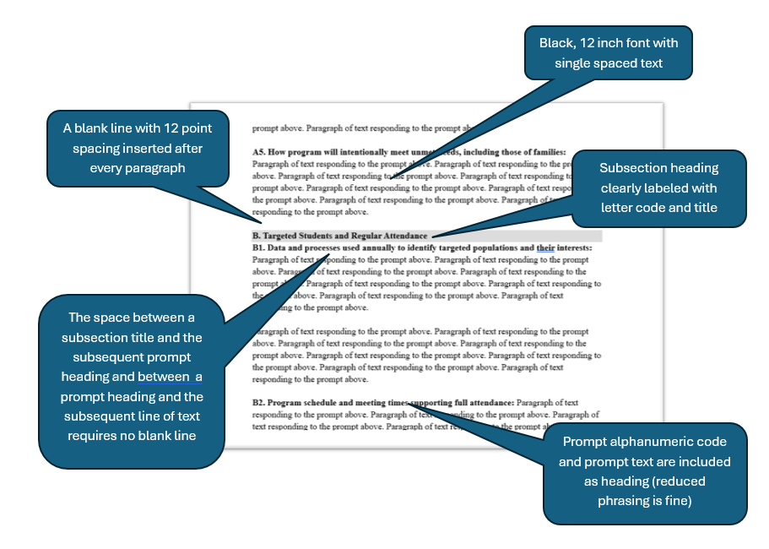
Criteria and image of compliant narrative formatting

Slide 40
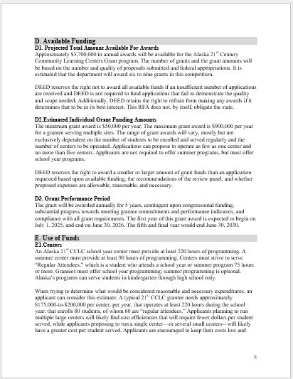
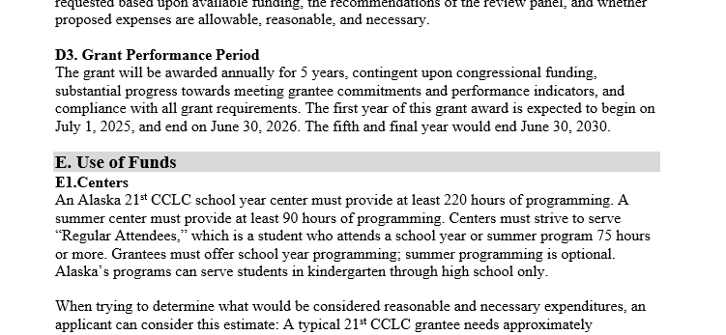
Examples of compliant narrative formatting

Slide 41
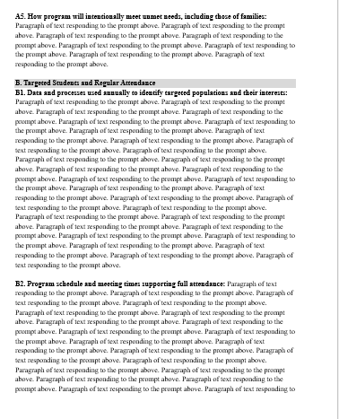
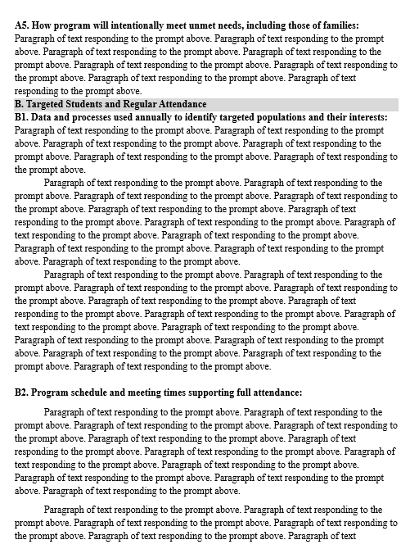
Examples of bad narrative formatting

Slide 42
Application Narrative Tips
A and B: If in small community, don’t select too narrow a target population (instead, most or all of your student body may have demonstrable need)
A and B: If in large community, narrow down who you will serve, but again, not too small a target
A3 and A4: (working with school and community) are excellent opportunities to have challenging conversations now rather than later. Get commitments and work out differences now. Get it on paper!
C 3: Use DEED Nutrition website (and staff) to learn about federal nutrition programs that provide snacks and meals to economically disadvantaged students.
D: Continuously ask yourself: Is this likely to lead to increased student academic achievement?
E: Consult AASB’s Alaska-centered Stronger Together resource

Slide 43
Application Narrative Tips continued
F: Use partnerships as a way to support and sustain other organizations in your community instead of competing and harming one another. Work out MOUs and attach in optional Appendix C and F.
G: Don’t shortchange your program of key administrative staff; this is key to good programming.
H: Look at resources on the “Resources” tab of the DEED 21st CCLC webpage
I: Brag about any of your organization’s demonstrable accomplishments
Throughout: Reference your “unscored” application package elements when relevant and to show consistency and support

Slide 44
Appendices Directions
Sections III and IV

Slide 45
Appendices
Appendices A, B, C, are required
Appendices D,E, F, G, H, I are optional
Appendices A – I cannot exceed 35 pages.
Appendix J is required and not included in the 35-page limit
Clearly label all with Appendix Letter given by DEED, even if you skip some Appendices/Letters
Don’t include additional documents
Tip: With exception of Budget Narrative, keep the appendices short (1-2 pages)

Slide 46
Appendix A: Budget and Budget Narrative
Should match the program the application described
Provide very detailed budget narrative
Be good steward; expenses should be reasonable and necessary; control cost per Regular Attendee and per “Participant Hour”
Allowable to briefly reference relevant in-kind, but detailed explanations and estimated dollar amounts should only go in the Optional Appendix E
Tip: Do a test print; cells can look fine on computer screen and then “cut off” when printed or turned to PDF
Templates found on 21st CCLC webpage
For year one only
Consult Expenditures Information on pages 11 – 15 and pages 30 – 31
Follow formatting requirements on pages 53 - 54
10 points
(20 points)

Slide 47
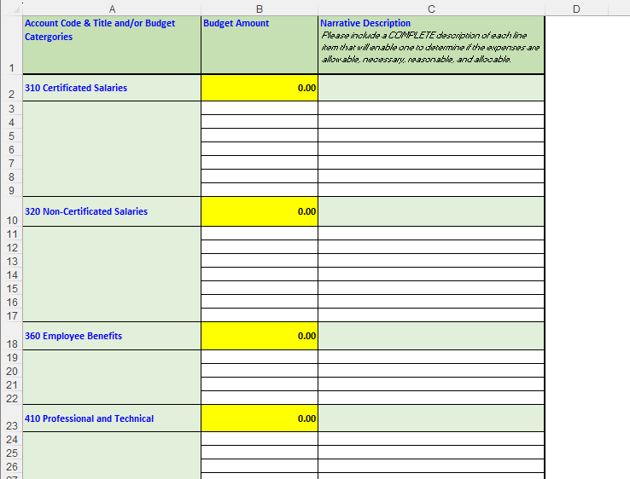
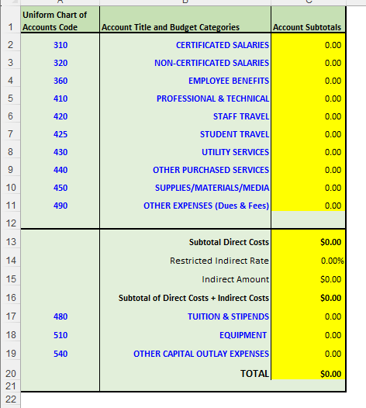
Budget and Budget Narrative Template
Complete the Budget Narrative first/only. Fill in white unlocked cells only. Will automatically transfer to Budget
Don’t break the formulas. Google sheets auto-unlocks, so it easy to break the formulas.
Check to make sure numbers add correctly down and across
If need to unlock “Budget and Budget Narrative Template” in Excel the password is 21cclc

Slide 48
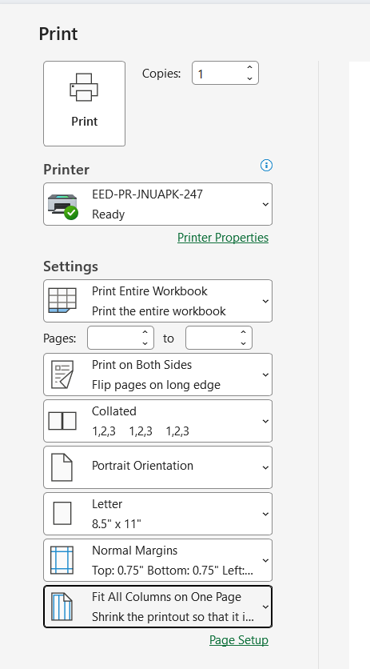
Budget and Budget Narrative Template printing
Columns of Budget Narrative should all fit on one page, but the rows should continue over many pages
Don’t select scaling that fits entire budget narrative to one page

Slide 49
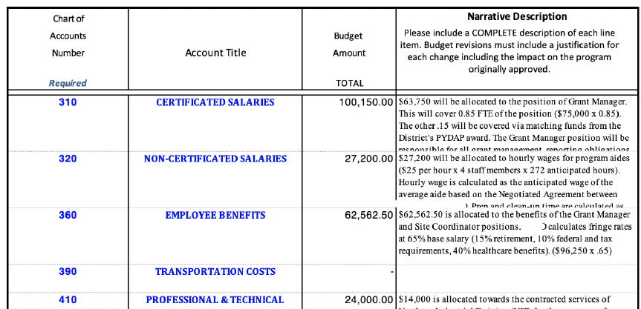
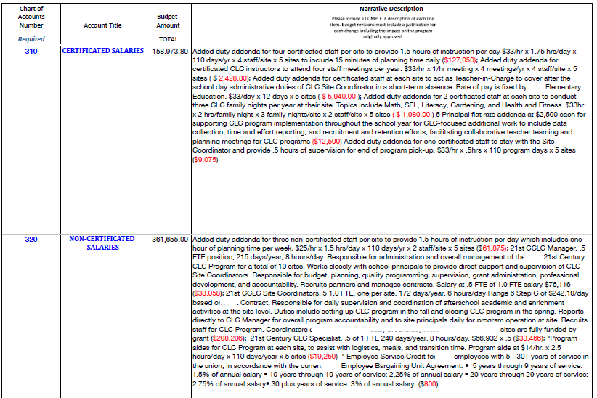
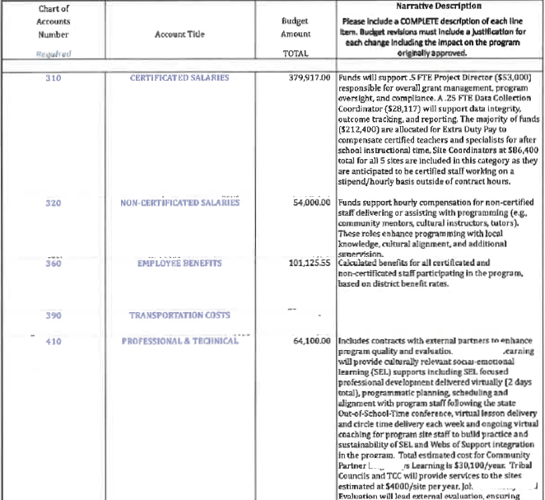
Example of bad budget formatting

Slide 50
Appendix B: Letter from Principal(s)
Suggested topics are on page 31
Tip: This will hopefully align with section A of the Application Narrative
Tip: Meet with the principal(s) and school(s) early in the process
Tip: If a school is not interested or does not demonstrate support for being served by this grant, do not pursue funding to do so
No Form
Attach one letter per school to be served
Signed
10 points total

Slide 51
Appendix C: MOU for key partnership
If you attach additional MOUs, they belong in Appendix F
Tip: This should address and clarify the partnership in Priority Points Opportunity A
No Form
Articulate commitments and expectations
Signed
Non-binding

Slide 52
Appendices D, E, F, G, H, I
These appendices are optional
D: Organizational Chart
E: In-kind Budget and Budget Narrative
F: Additional MOUs
G: Timeline for first year
H: Position Descriptions for up to 3 key positions
I: Applicant’s Choice
Tip: The final Application Package score is worth 15 points for “Overall Coherence, Viability, and Stewardship” of Application Package
No form
All these appendices are optional

Slide 53
Appendix
J
See guidelines and template on DEED 21st CCLC website
Recognize guidance is somewhat different from that districts may follow for other ESEA funds and Title VI funds
Tip: Do private school and tribal consultation early in the process
Tip: Use outreach attempts that naturally create documentation when contacting private schools and tribes (e.g. email, meeting invite, letter)
5 forms on pages 55 - 60
Signed
The Private School Participation Form must also have proof of consultation(s) (or attempt at consultation) attached
The Tribal Consultation Form must also have proof of consultation(s) (or attempt at consultation) attached

Slide 54
Consultation with private schools
The form provided in RFA is required
For the proof of consultation there are different templates provided that you can opt to use
If a school is not responsive or will not sign your affirmation, attach evidence of your multiple attempts.
Contact me if you need help determining which private schools would be eligible.
Many of you have no applicable private schools located within the attendance zone of schools you are proposing to serve
If you are a district, you can opt to do as part of regular annual ESEA private school consultation process if fits in application window
DEED has a Private School Ombudsman who can help you determine if there are private schools in your area.
The correspondence programs operated by Alaska districts are not private schools.
Someone homeschooling their own children is not a private school

Slide 55
Consultation with federally recognized tribes
The form provided in the RFA is required
Your affirmation must be signed by the tribal authority or someone appointed by the tribe for this purpose
If a tribe is not responsive or will not sign your affirmation, attach evidence of your multiple attempts.
Contact me if you need help determining which tribes are located in your area.
Almost everyone will have applicable tribes located within the attendance zone of schools you are proposing to serve; there are about 228 federally-recognized tribes in Alaska.
For the proof of consultation there are different templates provided that you can opt to use
If you are a district, you can opt to do as part of the regular annual ESEA tribal consultation process if fits in application window
The regional and local tribal for-profits corporations and the regional non-profit tribal organizations established via ANCSA are not what is meant by federally-recognized tribe.
For Southeast districts/organizations note that Tlingit and Haida (CCTHIA) is a federally recognized tribe for almost all SE communities in addition to the local tribe.
Use Map to determine which tribes; use BIA list for contact info

Slide 56
Score Sheet
Pages 62 - 70
There are several elements of the application package that have no specific points attached but can help to support, provide context, and demonstrate coherence for answers in the Application Narrative and elsewhere. Such important but unscored items include—
  Cover Page
  Table of Contents
  Project Abstract
  Program Eligibility form
  Schedule of Center Programming
  Appendices C - J
Additionally, there are 15 points for meeting this criteria: The contents of the application package, including appendices A through I—
  •Display overarching coherence,
  •Create confidence the applicant will be successful in achieving the project described, and
  •Demonstrate the proposal is a good use of limited 21st CCLC funds
Tip: Give reviewers reminders in narrative about other unscored portions of your application package

Slide 57
Overarching Tips

Slide 58
Tips for designing and implementation
Don’t understaff the key management positions: Site Coordinator and Director. Try to have at least one administrative role that is 1.0 FTE 21st CCLC, who will be the dedicated “leader” of the program.
Don’t try to serve too many centers; consider starting with one.
Consider focusing on a specific grade level: Instead of serving grades K-12 at four schools, try serving just grades K-5 at the four schools.
Don’t design programming that is overly narrow; it reduces adaptability. Maybe it is most appropriate for your organization to be a specialized partner who provides quality programming as just one part of a 21st CCLC program.
Don’t write a grant that will compete instead of cooperate with the community’s current resources. Don’t submit application if school or community does not support the program.
Don’t reduce existing programming and don’t supplant how existing programming is funded; your community will tattle on you.
Don’t overestimate the number of “21st CCLC regular attendees” who will voluntarily attend 75 hours or more; funding will be reduced; for typical K-12 school the average attendance is 35% of elementary students and 10% or less of secondary (could consider not serving).
Don’t focus on reviving a derelict building; must meet ADA compliance and safety regulations; try to use school.

Slide 59
Writing tips for application
Consider contracting a grant writer; your organization will still have much work to do to submit a grant application that is compelling and able to be implemented; can’t pay with grant funds.
For current or past grantees, don’t picture the DEED 21st CCLC Program Manager as the audience. Picture someone with less familiarity with 21st CCLC and with your organization. Do a brief explanation when needed.
For prior year Applicants, be aware of small changes, particularly in the Narrative Section, where questions /prompts may be tweaked, numbering changed, order changed, point values changed, etc.
The “Checklist” is the best one-page instruction that makes it clear what should be included in the entire Application Package.
Follow the Narrative limitations and double check at the end: Size 12 font, 1-inch margins, single-spaced, 12 point spacing after each paragraph except for headings.
Components might seem duplicative or redundant. Reviewers look for consistency and coherence throughout disparate parts (or at least sense a lack of it)
Many Application Package components aren’t directly “scored;” however, don’t leave out—may not review or weaken grant due to lack of supporting, corroborating, confirming documents. Additionally, there is up to 15 points for “Overall Coherence, Viability, and Stewardship” of Application Package

Slide 60
Writing tips for application continued
Plan and write as a group
Keep track of how much it will cost per “regular attendee” and per “student hour” (hours of programming x regular attendee); too high a cost per student or student hour won’t be competitive; don’t “pad;” don’t make it too expensive for the probable gain (form on page 42).
Remember that federal funds have many restrictions (incentives, snacks, celebratory food, entertainment are unallowable costs); additionally, costs must be “reasonable and necessary;” instead, can organization provide and list as in-kind support?
Be careful about saddling budget with costs that can be shared or provided in-kind
We will expect your organization and staff to actually do what you wrote in the application. In year one and in year five. Be realistic. Don’t set your organization and future staff up for failure.
If awarded, you application should be the Director’s “job description” and part of their employee manual
Take all of the advice and tips here with a grain of salt. Application scores are a complex result of reviewer understanding, the entirety of your Application Package, and how it compares to other applications submitted.

Slide 61
Tech tips for application
The RFA’s Table of Contents is “clickable;” you can also use the “Navigation Pane” (under View tab) to navigate the document by header.
Make your application easy for reviewers to view, understand, and navigate.
Consider using the “Headers” function of MS Word (under Home tab) for your own application—it can help make an automatic Table of Contents and auto-update page numbers to match. You can find instructions and videos online. Maybe you can repurpose the formatting in the RFA document
You must submit the entire Application Package as a single PDF file; don’t simply scan the entire document if possible because the degraded image reduces its readability
Make sure the Budget Narrative cells don’t cut off when printed or changed to a PDF
Do a test print. It is sometimes easier to spot issues. Also, reviewers may opt to read electronically or to print and read paper copy.
Submit 24 to 48 hours in advance

Slide 62
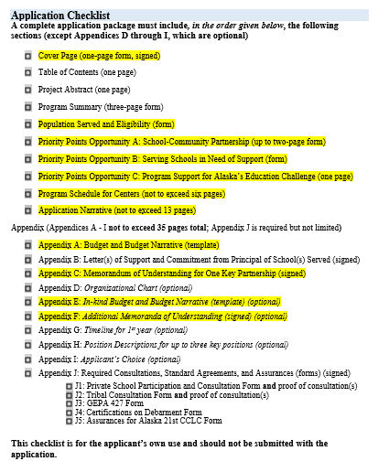
Final check
It is easy to submit inconsistent information—do final review
The “funding award request per year” is listed several places, including
  Cover Page Form
  Program Summary Form, pages 1 and 3
  Budget
  Budget Narrative
The Program Summary Form should align with information in multiple places, including at least all the areas highlighted in yellow

Slide 63
Next Steps

Slide 64
Next steps from here
If you didn’t attend Webinar #1, review recording and slides on the DEED 21st CCLC Website
Research
Community meetings
  Schools,
  Private Schools,
  Tribes,
  Partners
Local grant preparation and planning
Intent to Apply is due March 5, 2026
Application is due April 1, 2026; submit March 31st

Slide 65
Questions?

Slide 66
Questions
Can we apply only to do summer programming?
Must we include summer programming?
Do we have to supply an afterschool snack or a meal?
Can we use grant funds for the snack or meal?
Can we use funds for bus routes home?
Instead of a “center,” can we simply meet in a school?
Can a non-profit apply solo without partnering with a school district?
Can we charge participants a fee to attend?
If this isn’t the right funding source for what we want to do, what is?

Slide 67
Answers
Can we apply only to do summer programming? No
Must we include summer programming? No
Do we have to supply an afterschool snack or a meal? Yes
Can we use grant funds for the snack or meal? No
Can we use funds for bus routes home? Yes
Instead of a “center,” can we simply meet in a school? Yes
Can a non-profit apply solo without partnering with a school district? Yes, but harder for application to be competitive and harder to implement
Can we charge participants a fee to attend? Yes, but strongly discouraged, must be nominal/sliding scale, can’t make a profit, subtracted from award
If this isn’t the right funding source for what we want to do, what is? Try I-A, IV-A, REAP RLIS or SRSA, CTE, SIF, ANE, AAN mini grants, DOH PYDAP

Slide 68
Contact information
Jessica Paris, 21st CCLC Program Manager
jessica.paris@alaska.gov
(907) 465-8716
Website: www.education.alaska.gov/21cclc/

Slide 69
Stay connected
Website
education.alaska.gov
Social Media
@AlaskaDEED
Phone
Main Line: (907) 465-2800
Teacher Certification: (907) 465-2831

Slide 70
After the award – Grantee requirements
Do what you promised in your application
Comply with applicable state and federal statutes and regulations
Do data collection and federal and state reporting
Engage in local evaluation process
Participate in monitoring site visits
Attend directors meetings and conferences
Share best practices
Plan for sustainability

Slide 71
Final warnings for applicants
Understand that your application is a commitment, like a contract, and if you say you are going to do it (and you are funded) - we will expect you to do it.
Ensure the proposal follows guidelines/deadlines (timelines for submission, fonts, charts, orientation etc.)
Determine if the proposal is more appropriately funded through other sources
Be aware of other program or application efforts in your community
Ensure the proposal is not too expensive for the probable gain
Most grant dollars should be focused on services to the intended population
Only ask for what you need
Do not “pad” budget
Budget should match your programming
Demonstrate capacity to provide proposed services
Details, details, details
Include realistic plans for hiring expertise, if necessary
Applicants should anticipate for unforeseen changes; such as difficulties in hiring personnel, and plan accordingly

